Slide 1
Cs-381 Software Engineering
Course Instructor: Dr. Shazia Arshad
Notes:
Welcome to all of you in this course. I am Dr. Shazia Arshad. I will be your instructor for this course.

Slide 2
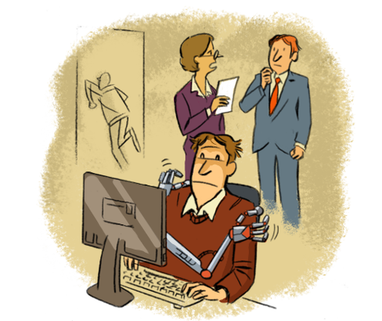
What is Software ???
Notes:
So what is a software??? Any guess or idea????
Probably by name of software people think that software means writing code.
So take an example to elaborate this concept:
First lets look at the figure shown in slide. The situation of a graduate student is shown here who is seen sitting in front of a computer and probably doing coding. This student is going for an interview in a software house. The interviewer asks several questions from him and the student fails to provide satisfactory answers for the questions but the student is very good at coding. He always score A grade when it comes to write a code.
What does it means????
Is he nervous while answering questions???
Does he writes code by using unfair means or by cheating???
Can you people figure out the reason?? (He is one of those student who are good at coding or lab but fails in theory class.)
Only coding is just like this blank student.
Similarly, just aa piece of code is not enough to describe what is going on in the code and why the code is written. A user needs complete documentation or user guide manual with the software to understand its working and features.
But Software is a set of instructions, data or programs used to operate computers and execute specific tasks.

Slide 3
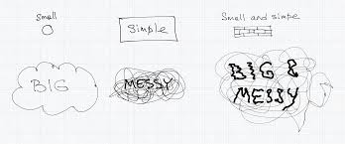
Need for Software
Example:
E-pay Punjab
Notes:
The question is why need to study this course: software development process or software engineering will be answered once it becomes clear that why we need to develop software or need for software development. From the figure, it is seen that completion of any small or simple task is easy, but as the task size increases, it becomes difficult for the humans to handle it manually. Consider the example of a MOBILE APP,
SMALL CASE: keep track of number of vehicles used in a particular city by an individual in a PARTICULAR CITY. (like ek owner k name pe kitni cars register ha)
SIMPLE CASE: keep the record of each model of car used in a particular city.
SIMPLE and SMALL CASE: having the record of NUMBER of vehicles of DIFFERENT MODEL registered against an individual.
BIG CASE: keep track of number of vehicles used in a COUNTRY by an individual and having record of MODEL of car used by that individual.
MESSY CASE: having data of TAX & TOKEN of vehicle paid by owner for each vehicle he owned with amount paid and date on which it is paid.
BIG & MESSY CASE: Combining all of the previous factors.
Obviously it is difficult to collect and maintain this record. That's where we need software which can do this for us. E-PAY PUNJAB is an app having similar functionalities.

Slide 4
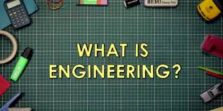
Notes:
Software Engineering consists of 2 parts: Software and Engineering.
So, what is Engineering????
The way to use scientific knowledge in a productive way.
Engineering is a scientific field and job that involves taking our scientific understanding of the natural world and using it to invent, design, and build things to solve problems and achieve practical goals. This can include the development of roads, bridges, cars, planes, machines, tools, processes, and computers.

Slide 5
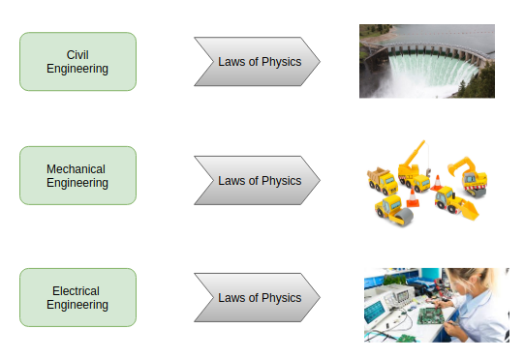
What is engineering?
Physics itself is NOT Engineering.
Software Engineering is related to Computer.
Notes:
All other engineering fields are related to PHYSICS. These engineering disciplines are based on the laws of PHYSICS,
Is PHYSICS itself is called engineering????

Slide 6
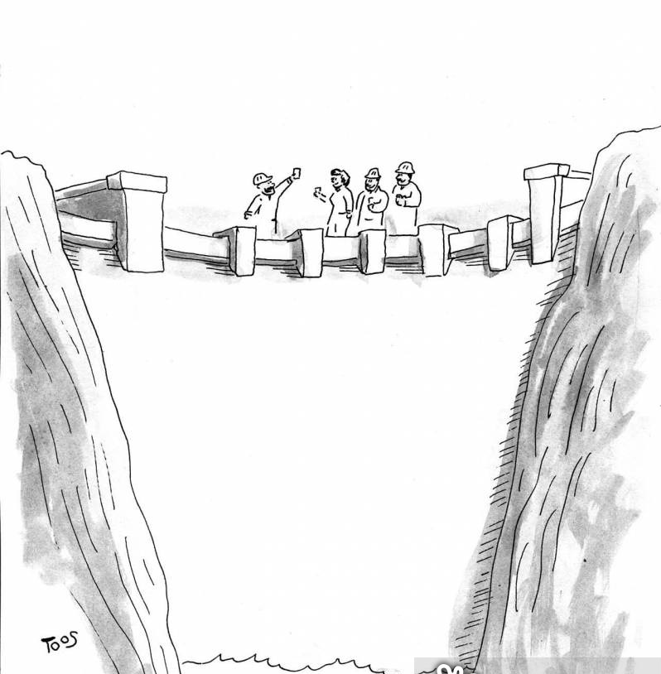
What is software engineering??
Example:
Construction of a dam
Notes:
Next question is what is software engineering???
How the knowledge of computer science can be used in effective production of software system is called software engineering.
Just as other engineering types includes construction, maintenance and updating time to time, software engineering also involves development, testing and doing necessary changes from time to time.
Take example of Civil Engineering and building a dam,
You will probably think that the civil engineering is hard but Civil Engineering in software is harder.
During building of a dam, if they got halfway through building it, and they saw a huge crack in the concrete,
they'd be able to identify and fix that.
On the other side, finding defects called bugs in software is difficult.
The thing about software is that, it's intangible.
We can't see it, we can't see when we've made mistakes; and it's hard to see for sure that it isn't working right, especially at the grand scale.
If the program is wrong and the tests are wrong, we DON'T even know there's a problem.
That's what makes software engineering process so important.
So it is difficult to dealing with something this complex. For this we need to learn about the process and follow it.
It gives you the roadmap to success. That's where software engineering plays its role.

Slide 7
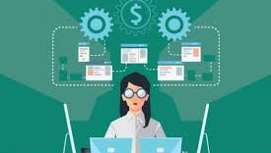

Software / other engineering
Notes:
Can software wear out???
If any component of other engineering product goes fail, they can be replaced.
If the wheel of a car get burst, it can be replaced.
But in case of software, there iss NO REPLACEMENT of any component.
1) Software does NOT wear out.
2) Continuous changes in ALL Dimensions.
Continuous improvements have been made by software industry researchers in different dimensions for changes (interface changes to make it friendly, etc etc).
Frequency of CHANGES result in prodction of Errors.
Nature of changes being made is also very different.
There involves both fundamental anad minor changes in software industry as opposed to other industries which involves only minor changes.
For example, consider the changes done in a car company in year,
Consider the models released by a company in a year??

Slide 8
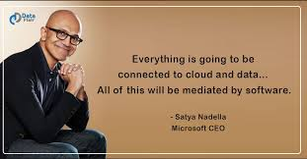
Why Study SOFTWARE engineering??
Notes:
Why we study software engineering ??? Before diving in the course of software engineering, it is necessary to answer this question. Any idea !! So as shown in the slide, the CEO of Microsoft says predict that in future everything will be connected to internet. In such a situation, where everything will be automated and software becomes the necessity of life, it is necessary to study methods of software development and maintenance called software engineering.
Software Engineering provides you software development lifecycle . As a software engineer what you will do,
is take these templates, these plans, these processes, and make engineering decisions necessary to adapt them to your needs, to your project's constraints.
Importance of Software:
Business
Scientific Calculation
Bioinformatics-DNA coding
Games Derived from Software
Gadgets e.g Car Trackers
Economic Activities.

Slide 9
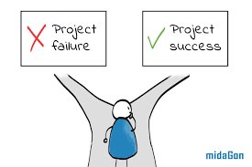
failed projects
Notes:
Why do most of the projects fail???
According to stats, in 2015, about $81 billion are wasted in canceled projects and 19% of the projects failed.
That means that either the project was canceled before it could finish or, project was finished, but people did not find use of it. So, one in every five projects failed.
Mostly the projects failed in requirements or failed to satisfy user needs.
The reason for failure is developers DID NOT follow proper software development process or software engineering steps. So hopefully, you understood the importance of learning about software process and methodologies.

Slide 10

MOTIVATION
Notes:
A car needs service on regular basis for its long term working. Just like we expect car to work all the time and can't afford to break or reboot unexpectedly, software industry needs to continue to learn better ways to build software.
It were to become an integral part of human life and that's the motivation for this course.

Slide 11
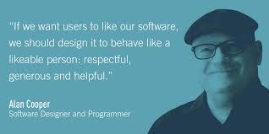
Notes:
How to make sure that the user will like your software???
What features should the software have to be acceptable and become popular in community???
How to classify good and bad software???
The ultimate goal of Software Engineering is developing a software which is useful for the community, which can serve to help others.
As ALAN COOPER said (in slide above), a good software should have following qualities:
Correctness: The software which we are making should meet all the specifications stated by the customer.
Usability/Learnability: The amount of efforts or time required to learn how to use the software should be less. This makes the software user-friendly even for IT illiterate people.
Reliability : The software product should not have any defects. Not only this, it shouldn't fail while execution.
Efficiency : This characteristic relates to the way software uses the available resources. The software should make effective use of the storage space and execute command as per desired timing requirements.
Safety : The software should not be hazardous to the environment/life.
Security : The software shouldn't have ill effects on data / hardware. Proper measures should be taken to keep data secure from external threats.
All of these qualities will be achieved by following software engineering principles.

Slide 12
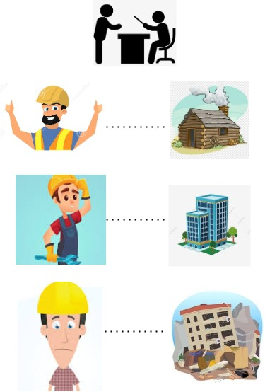
Software CRISIS
Notes:
How the SOFTWARE ENGINEERING term was devised??
Consider the example, the persson is told to build a cottage by boss. He successfully builds a cottage and is very happy.
Now,, the builder is told to build a multi-story building. He did his efforts but is still confused.
Next, the building created by builder collapsed and he is very sad now.
Can you guess why the building collapses but cottage not??
Building (highly complex structure) was created using the OLD, FABRICATED RULES by which cottage was constructed.
So, clearly, the rules used to build cottage was NOT enough for constructing a building.
Similarly, the rules used to write SMALL, SIMPLE program was not sitable for developing HIGHLY COMPLEX software.
So, the conference was held after 1960 to discuss the software development methods where the term SOFTWARE ENGINEERING was devised by SOFTWARE ENGINEER RESEARCHERS.

Slide 13

Software Engineering AS A Balancing Act
Quality Performance
Response Time
Interactive Interfaces
Efficiency
Integrity
Cost Effective
Notes:
Lets consider a scnerio where the enemy is attacking,. You are required to develop a software for operating nuclear weapons.
Whata will be the MOST IMPORTANT factor in this case???
Above mentioned are some features related to a software in this case.
How to keep balance between different factors ???
Role of software engineer is to keep balance between these CONFLICTING REQUIREMENTS.

Slide 14

Project breakdown
BREAK EVEN POINT:
1) Point where total costs (expenses) and total sales (revenue) are equal.
2) There is no net profit or loss.
Break Even Point = fixed costs / (Price per unit - Variable costs)
Notes:
Imagine you are a interior designer???
You need to décor your home. Enlist the steps involved in HOME DÉCOR.
Similarly, before starting a project, PROJECT MANAGER needs to break the project into steps. Project is divided into tasks, each task is allocated to a specific team. Team is responsible for the completion of task and providing DELIVERABLE.
Breakdown of a software project usually involves following activities:
Project Management
Requirement Engineering
Design
Coding
Testing
Software Quality Assurance
Configuration Management
Integration
User Documentation
Rest of Activities

Slide 15
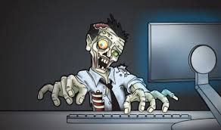
PROJECT AS A Nightmare
Notes:
When does a project becomes a nightmare??
Imagine the project is NOT completed on time. As the time goes on, project becomes a NIGHTMARE for team manager.
Missing Schedules
Mismanagement
Team conflict issues
Budget Exceeds

Slide 16

TIME TO THINK
5 MAJOR REASONS OF PROJECT FAILURE
Notes:
So, its time to check if you are active or not???
HIGHLIGHT THE 5 MAJOR REASONS OF PROJECT FAILURE.

